Slide 1
FAKE NEWS DETECTION
KUMAR GOURABH

Slide 2
Business Problem Framing
Need to classify if a news is fake or not, based on the Author’s name, Headline and the actual content of the article.
The authenticity of Information has become a longstanding issue affecting businesses and society, both for printed and digital media.
On social networks, the reach and effects of information spread occur at such a fast pace and so amplified that distorted, inaccurate, or false information acquires a tremendous potential to cause real-world impacts, within minutes, for millions of users.
Recently, several public concerns about this problem and some approaches to mitigate the problem were expressed

Slide 3

Data- Description:
There are 6 columns in the dataset provided to you. The description of each of the column is given below:
“id”: Unique id of each news article
“headline”: It is the title of the news.
“news”: It contains the full text of the news article
“Unnamed:0”: It is a serial number
“written_by”: It represents the author of the news article
“label”: It tells whether the news is fake (1) or not fake (0).

Slide 4
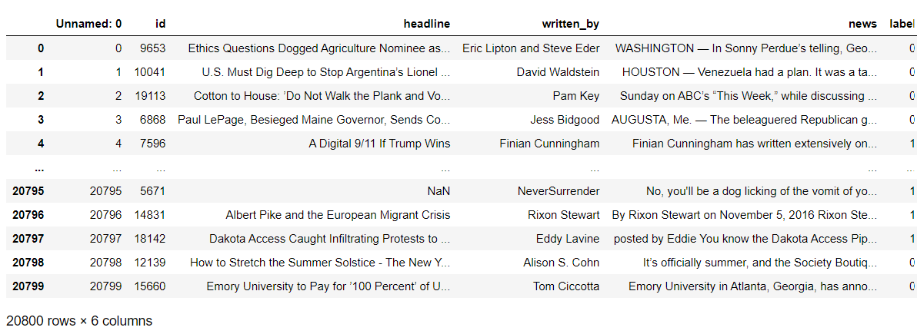
Dataset
The figure shows how the given dataset looks like

Slide 5
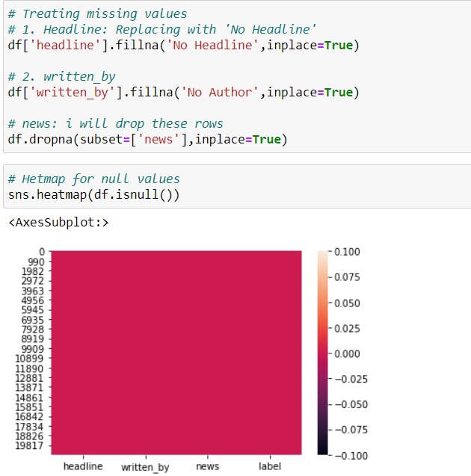
Handled Missing Values:

Slide 6
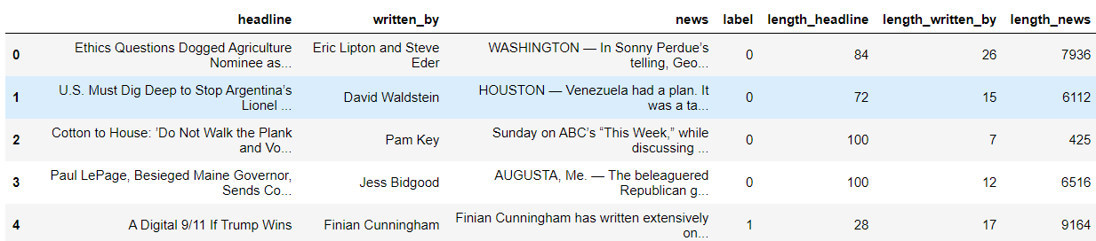
Calculated Lengths of Features

Slide 7
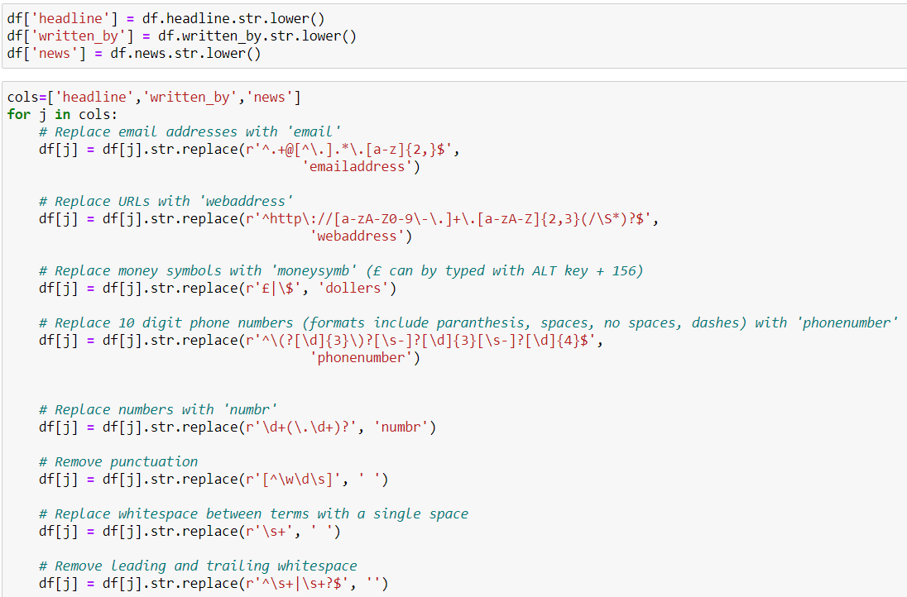
Using NLP to Solve Problem
Here the idea is to vectorize the contents so that the meaning of the article can be understood by the machine. The following pre-processing steps were done:

Slide 8
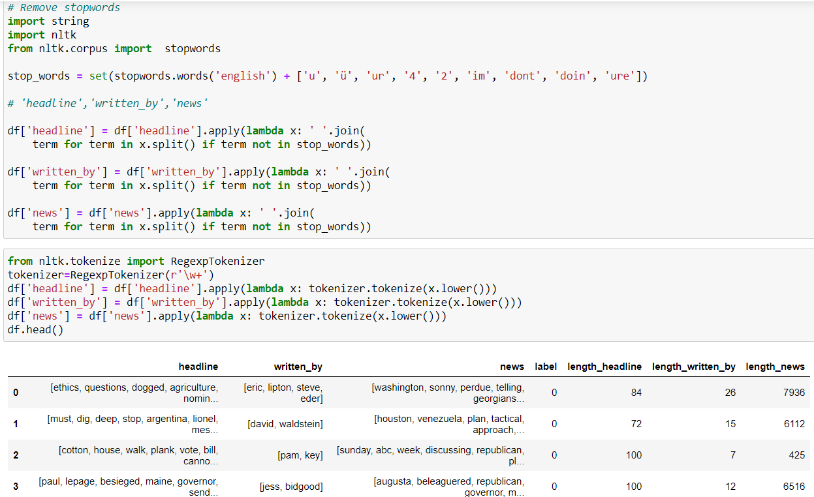
Stop Words Removal
We need to remove words like for, of, the etc. which do not actually add to the context so that our processing speed is reduced

Slide 9
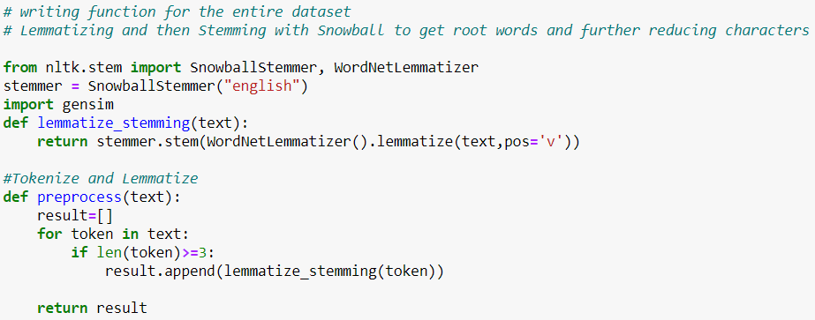
I have performed lemmatization and stemming on the features – Headline and news. This is done to find the root words.

Slide 10
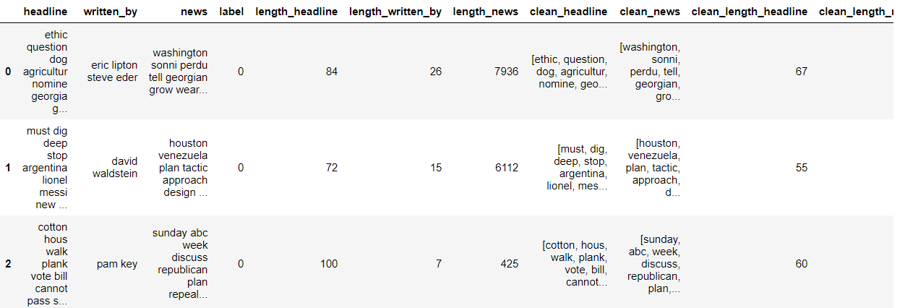
Finally, we can see the counts of actual data and data after pre-processing

Slide 11
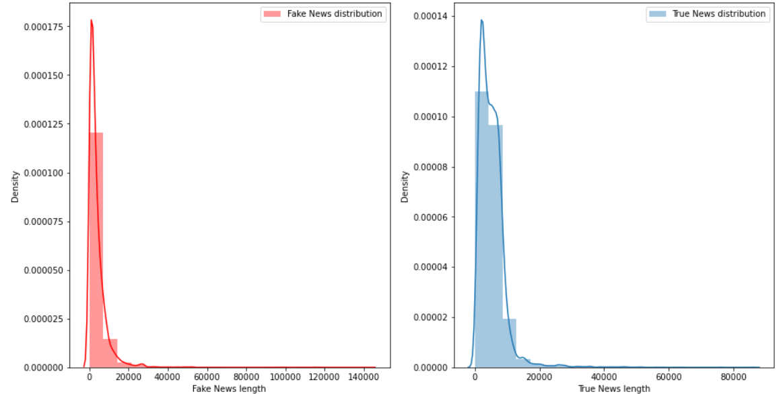
Distribution of News before Cleaning

Slide 12
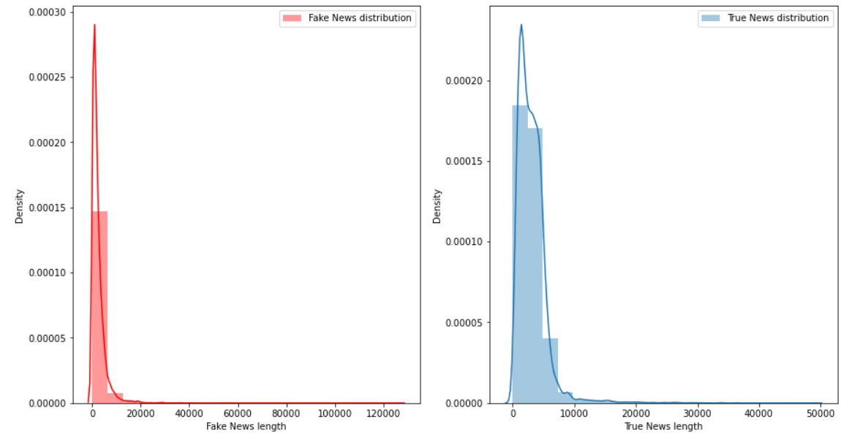
Distribution of News after Cleaning

Slide 13
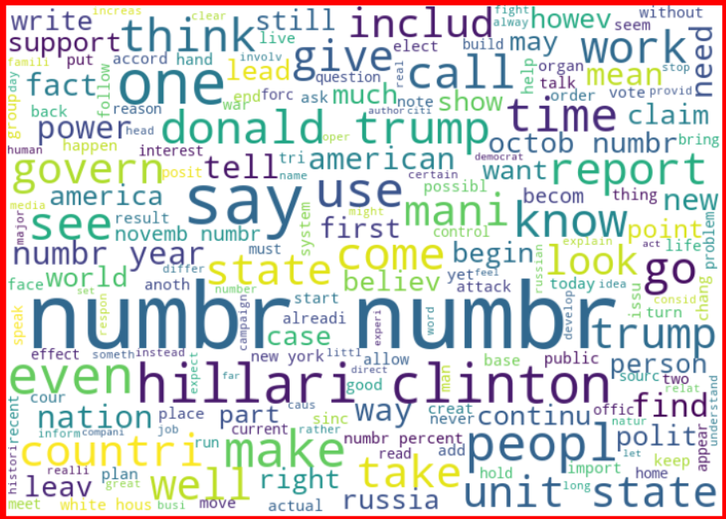
Word Cloud for Fake News for News Column

Slide 14
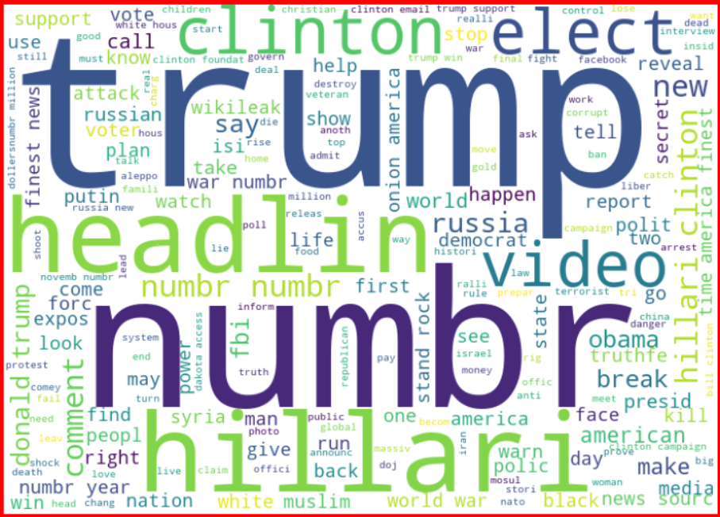
Word Cloud for Fake News for Headline Column

Slide 15
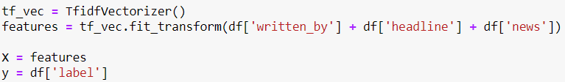
Next, I have vectorized using tf-idf vectorizer so that words are arranged in a 2-d area based on similarity or difference in their meaning
Also, prepared X and y variables for model building

Slide 16
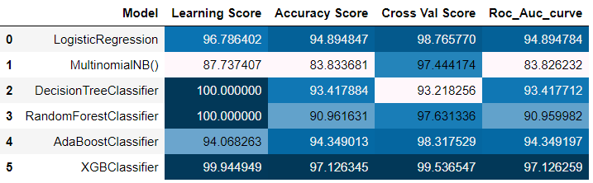
Let’s have a look at the Model Performances

Slide 17
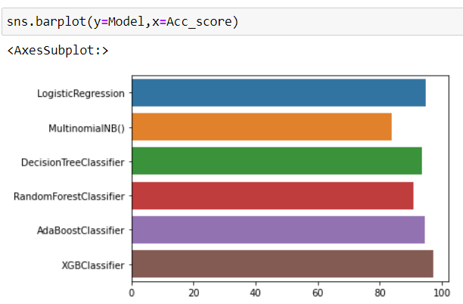
Accuracy Scores of Various:

Slide 18
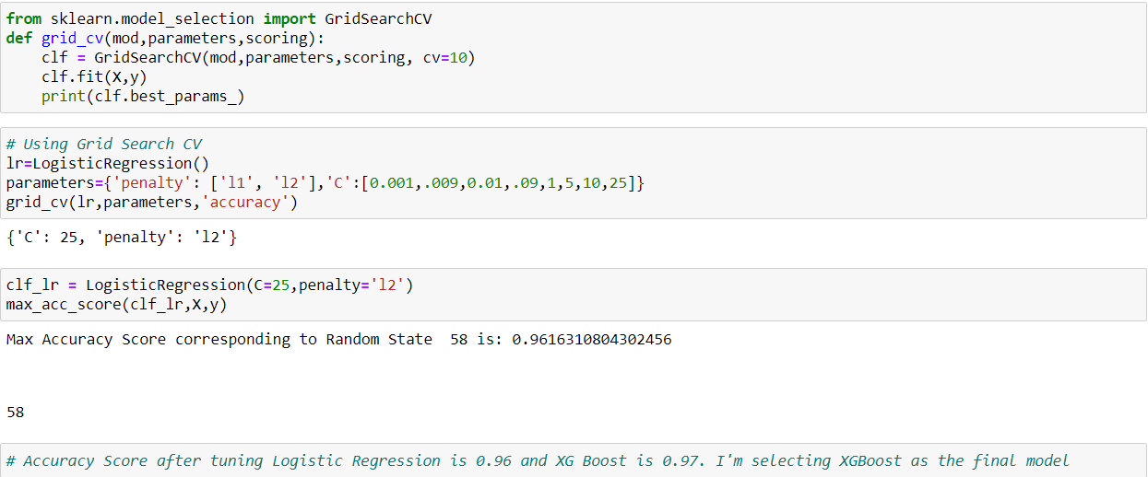
XG Boost seems to be the best performing model. But Let's try to tune the hyperparameters of Logistic Regression to see if we get a better model score

Slide 19
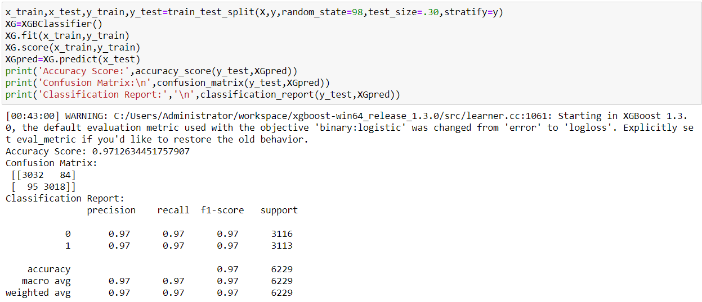
Final Model

Slide 20
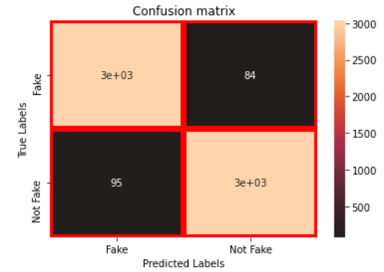
Confusion Matrix

Slide 21
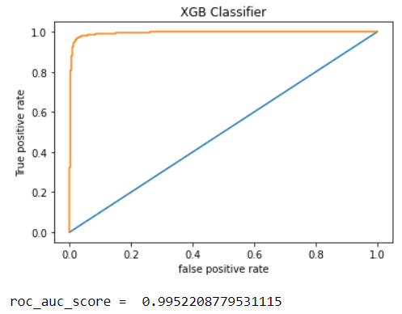
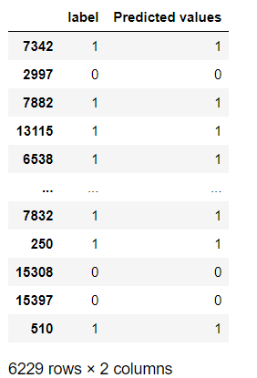
Roc_Auc Score and Predicted Values

